Slide 1
The Government of the UAE.

Slide 2
The President of the UAE.

Slide 3
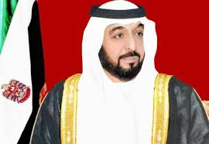
The President of the UAE.

Slide 4
The President of the UAE.
Khalifa bin Zayed Al Nahyan

Slide 5
The Prime Minister of the UAE.

Slide 6
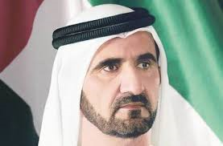
The Prime Minister of the UAE.

Slide 7
The Prime Minister of the UAE.
Mohammad Bin Rashid Al Maktoum

Slide 8
The Federal Supreme Council.

Slide 9
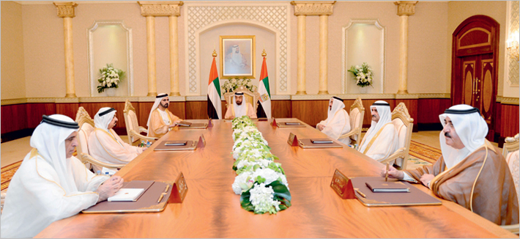
The Federal Supreme Council.

Slide 10
The Cabinet.

Slide 11
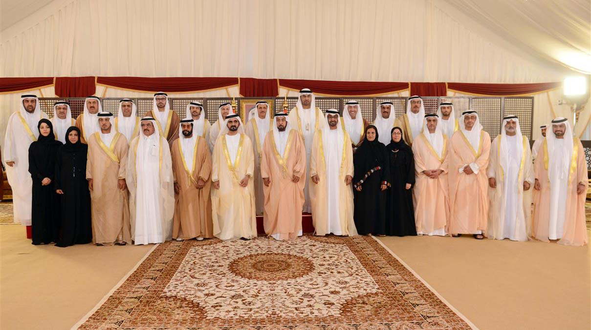
The Cabinet.

Slide 12
The Ministries of the UAE.

Slide 13
The Ministries of the UAE.

Slide 14
The Ministries of the UAE.

Slide 15
The Ministries of the UAE.

Slide 16
The Ministries of the UAE.

Slide 17
The Ministries of the UAE.

Slide 18
The Ministries of the UAE.

Slide 19
The Ministries of the UAE.

Slide 20
The Ministries of the UAE.

Slide 21
The Federal National Council.

Slide 22
The Federal National Council.

Slide 23
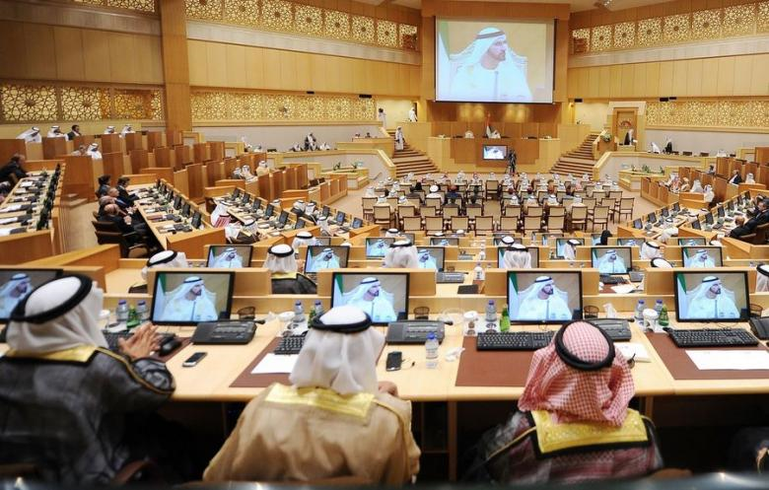
The Federal National Council.

Slide 24
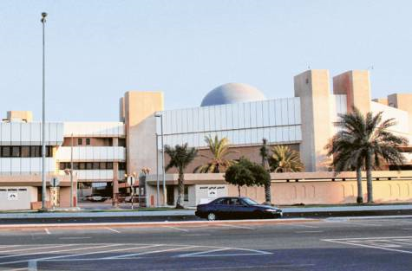
The Federal National Council.

Slide 25
The People of the UAE.

Slide 26
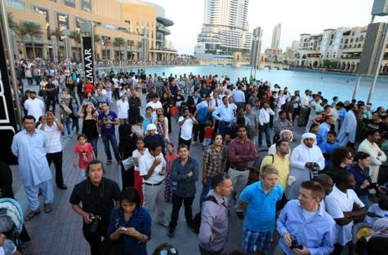
The People of the UAE.

Slide 27
The President of the UAE
The Prime Minister of the UAE.
The Federal Supreme Council.
The Cabinet
The Ministries of the UAE
The Federal National Council.
The People of the UAE

Slide 28
